Slide 1
Welcome to the Leadership and Campus Life Presidents and Advisors Workshop

Slide 2
Agenda University Accounting Funding Marketing Meeting and Conference Service Leadership and Campus Life Service Volunteer Center

Slide 3
University Accounting 303 Whitehurst 405-744-5881 Lynette Venard

Slide 4
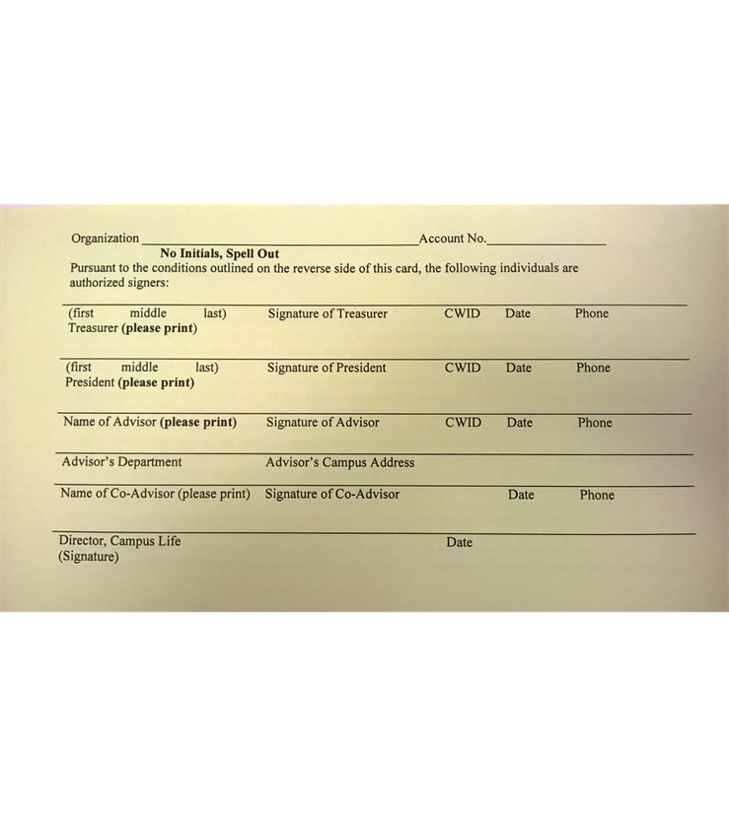
Signature Card
Often called a “Yellow Card”
Campus Life 211 Student Union
Update Campus Link
University Accounting will compare signatures from signature card to disbursement voucher in order to process disbursement vouchers

Slide 5
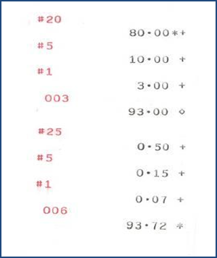
Deposits
Must be made within 24 hours of receipt of funds
Take deposit transmittal form with funds to Bursar’s office in 113 Student Union
Need name of student organization, fund code, phone number of treasurer and phone number of advisor on back of checks
Must include adding machine tape – An adding machine is available to students in Leadership and Campus Life 211 SU

Slide 6
Disbursement Vouchers
Disbursement vouchers available in 304 Whitehurst
To reimburse a student – CWID along with name and address
To pay a company – must have FEI number (tax ID number) along with name and address
Voucher must be signed by President or Treasurer and Advisor

Slide 7
Disbursement Vouchers
Include itemized receipt or invoice to be paid or reimbursed
Itemized original receipt must include date of transaction, amount, vendor name and itemized description of item(s) purchased & show proof of payment
Invoice to be paid is to be placed between yellow and green copies of voucher below perforation
If mailing a form to vendor, must include extra copy and attach it to green copy of voucher

Slide 8
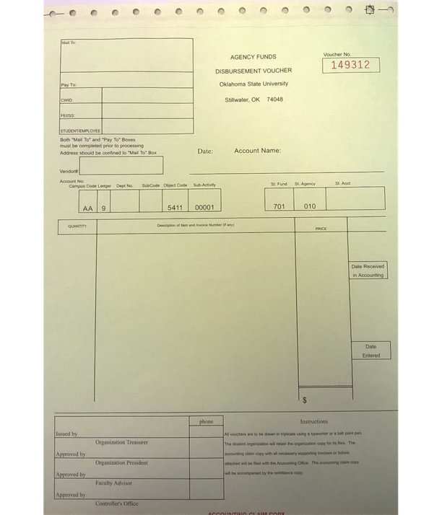
Disbursement Vouchers
Check should be issued within 2 weeks after being approved for payment by University Accounting
Treasurer will need to keep gold copies of the disbursement vouchers to reconcile with FGRODTA’s
Student organizations are not exempt from paying sales tax

Slide 9
Campus Vendor Invoices
If purchase items from bookstore or rent vehicles from Motor Pool, OSU campus department will charge student organization (DO NOT use disbursement voucher)
Examples: Motor Pool, Student Union bookstore, Daily O’Collegian and Physical Plant work orders

Slide 10
Purchasing Gift Cards
Maximum amount $25 per card – limit of $250 for all cards
Keep log with name, address, CWID, and amount of gift card for each recipient
Each recipient must sign log. That log must be attached to disbursement voucher.

Slide 11
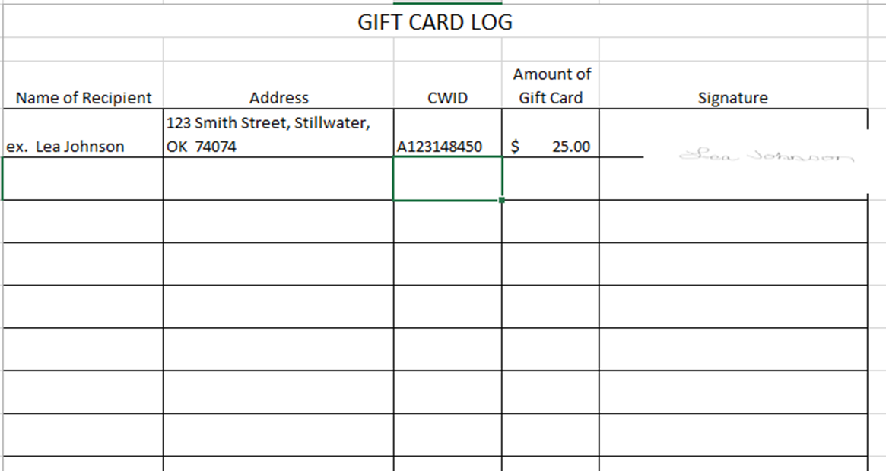
Gift Card Log Example

Slide 12
Transfers
Student organizations may transfer funds to another student organization
Memo needs to include current date, name and fund number (1-991XXX)of student organization receiving funds and name and fund number (1-991XXX) of student organization paying funds
Memo must be signed by President or Treasurer and Advisor of organization paying the funds

Slide 13
Donations
Student organization receiving AFAP funds can’t use those funds to make a charitable donation
Use a disbursement voucher to make a donation
Required documentation includes copy of deposit showing funds were deposited into the student organization fund and a memo with description, name and address of charity. Memo must be signed by the advisor

Slide 14
Accounting Reports
Available around 1st working day of month from advisor
FGRGLTA/FGRFAAC – provides monthly fund balance
FGRBDSC – provides current month and year to date amounts for revenue and expenses
FGRODTA – lists all transactions for revenue and expenses for the current month

Slide 15
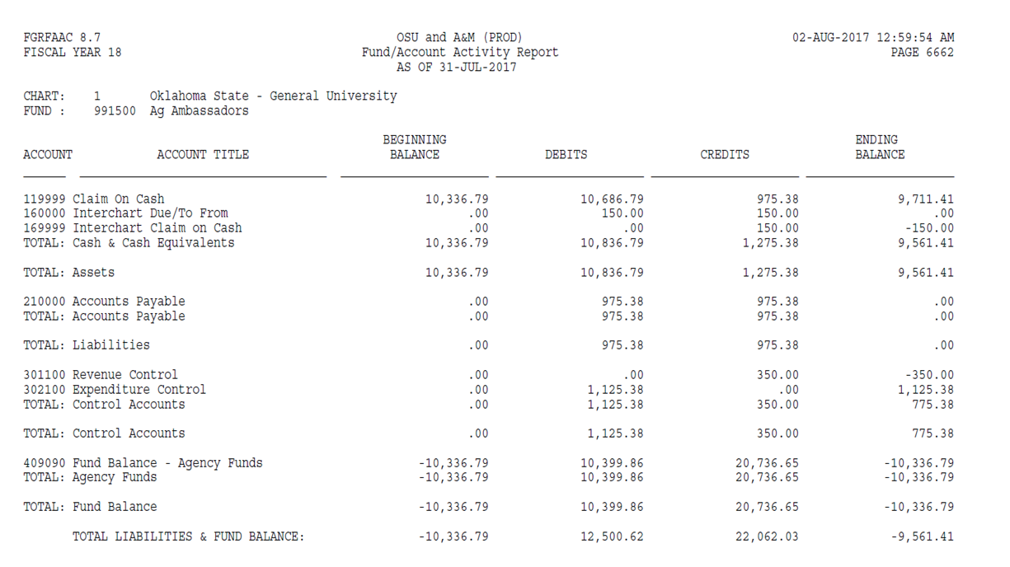
FGRGLTA / FGRFAAC

Slide 16
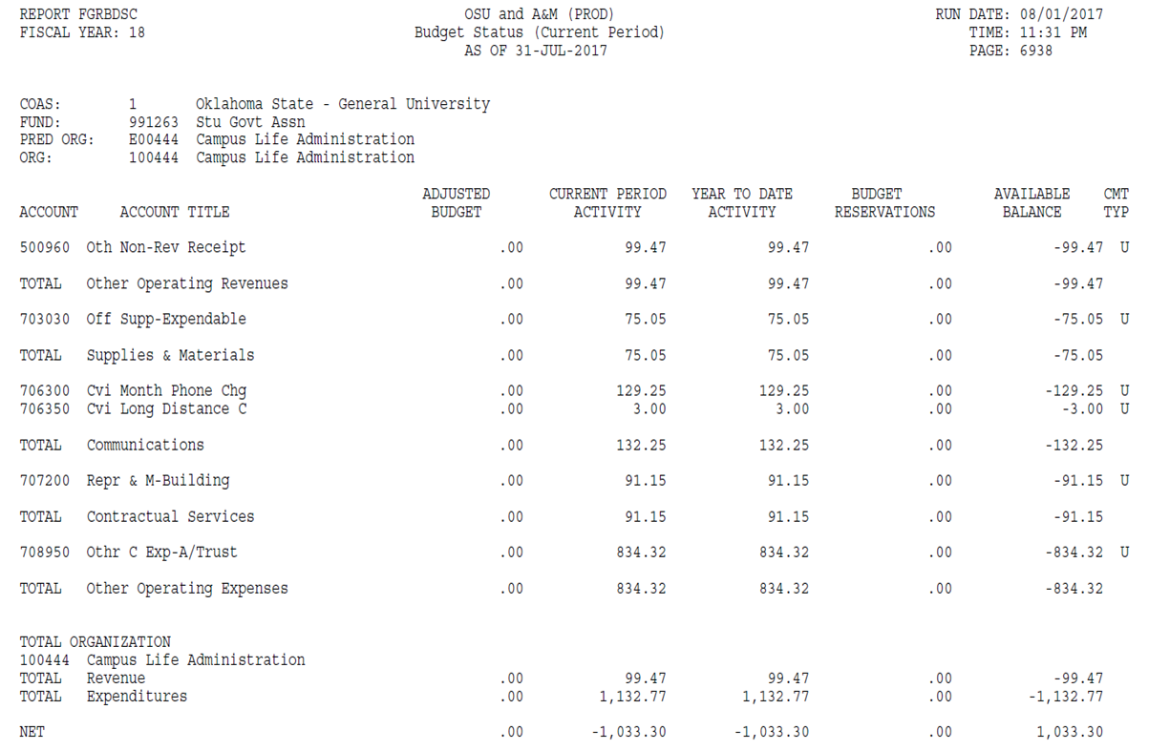
FGRBDSC

Slide 17
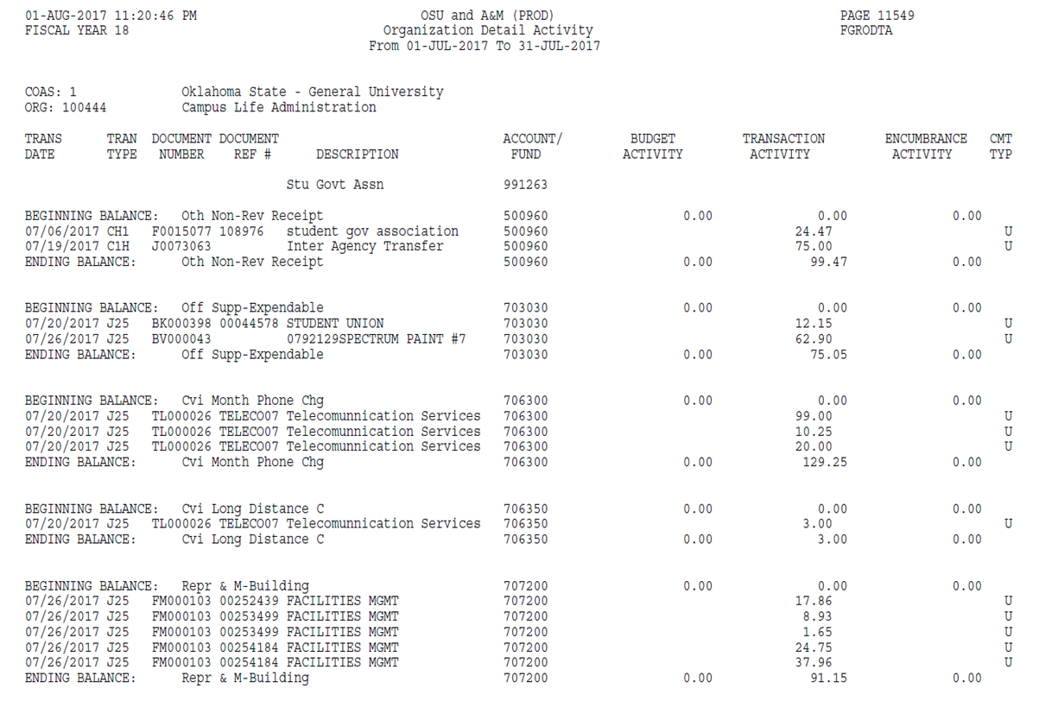
FGRODTA

Slide 18
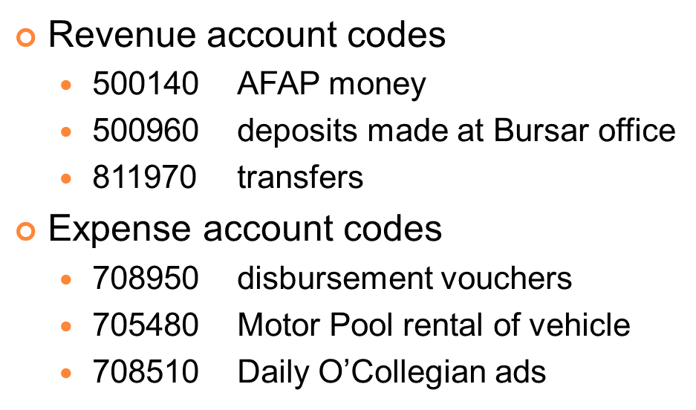
Accounting Reports

Slide 19
PCARD

Slide 20
Any questions??

Slide 21
Funding

Slide 22
Organization Funding
Graduate Student Organizations: GPSGA is the funding source for Graduate groups
Sports Organizations: Sports Club Council is the funding source for Sports Clubs and they are not eligible for SGA funding

Slide 23
AFAP Funding
Activity Fee Allocation Process
Purpose: A certain portion of student activity fees are set aside each year to be disbursed to student organizations to carry out programming
Amount: Varies greatly dependent upon need.
Eligibility: Only Group 1 Recognized student organizations are eligible. These groups must also be “current” with CampusLink and University Accounting as well as have completed the Treasurer’s training module during the current school year. Groups that have not processed repayment of unused SGA funds from previous semesters will not be eligible.
Process: Applications become available by December. They must be completed on-line. After the deadline has passed (in late January), a series of hearings will be held to consider funding request. Once allocations have been approved by the university president, funds will be disbursed in two equal payments – one each in the fall and spring semester of the following academic year.
Deadline: Last Friday in January

Slide 24
SGA Co-Sponsorship
Co-Sponsorship:
Purpose: A certain portion of student activity fees are set aside each year to be disbursed to student organizations for use in carrying out one-time events. This can include, but it is not limited to a program that is being hosted or sponsored by the student organization or attendance at a conference.
Amount:
Group 1 Registered student organizations are eligible to receive up to $500 a year (until fund is depleted)
Group 1 Recognized student organizations are eligible to receive up to $1000 a semester (until fund is depleted)
These groups must also be “current” with Leadership & Campus Life and not have any outstanding repayment due to SGA.
Process: Submit an application via the website:
http://osusga.okstate.edu/images/Documents/co-sponsorship.2.14.13.fillable.pdf
A representative must attend the SGA Budget Committee Meeting and SGA Senate Meeting when the co-sponsorship is being considered. Once the legislation has passed, funds will be transferred directly into the organizations account.
Deadline: Applications must be submitted prior to the event or conference the organizations is requesting funding for. Applications submitted by 4pm on Wednesday may be discussed at the next weeks SGA Budget Committee Meeting.

Slide 25
SGA Multicultural Affairs Funding
Multicultural Affairs Committee (MAC):
Purpose: To assist any student organization that wishes to promote multicultural interaction and activities on the OSU campus
Amount: Varies depending on need.
Eligibility: Must be a registered student organization.
Process: Submit an application which includes a description of the event or conference with a detailed budget on the website:
https://app.it.okstate.edu/sga_forms/index.php/module/Default/action/ViewForm/form_key/50
Attend the SGA committee meeting for the request to be heard. Funds will be transferred directly into the organization’s account once the committee has made a decision to fund the group.
Deadline: No deadline, groups can apply throughout the fall and spring semester

Slide 26
Meeting and Conference Services
179 Student Union
405-744-5232
207 Wes Watkins Center
405-744-9359

Slide 27
Forms, Guidelines, and Policies http://meetings.okstate.edu/guidelines
Forms:
Student Union Indoor Request Form
Outdoor Event Request Form
Tabling Request Form
Campus Signage Request Form
Food-on-Campus Waiver Application
Alcohol Beverage Service Request Form
Guidelines & Policies:
Guidelines for the Use and Scheduling of Public Spaces of the OSU Center for Student Services
Policy Governing use of the OSU Student Union Public Space
Building and Public Service Area Hours
Student Union Solicitation Policy and Procedure
Student Union Guidelines on Dances, Social, and Public Events
Guidelines for the Service of Alcoholic Beverages in the SU
Guidelines for the Use of Bennett Chapel

Slide 28
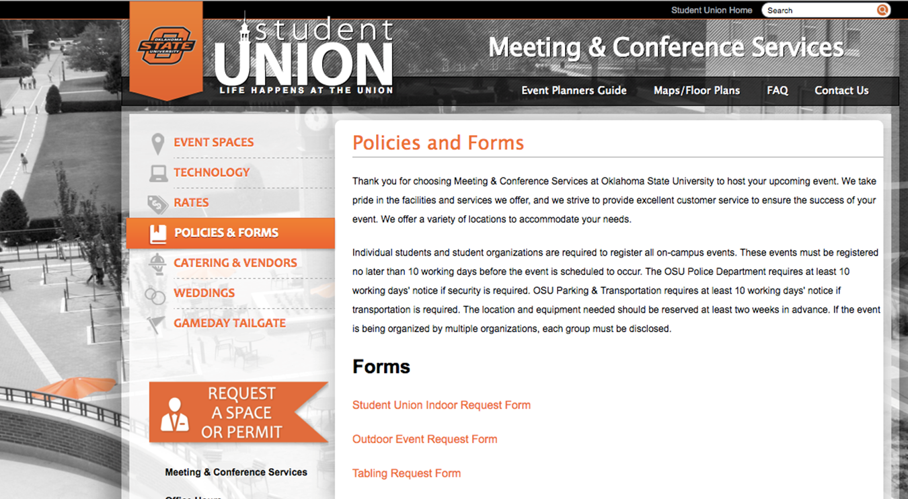
Forms, Guidelines, and Policies http://meetings.okstate.edu/guidelines

Slide 29
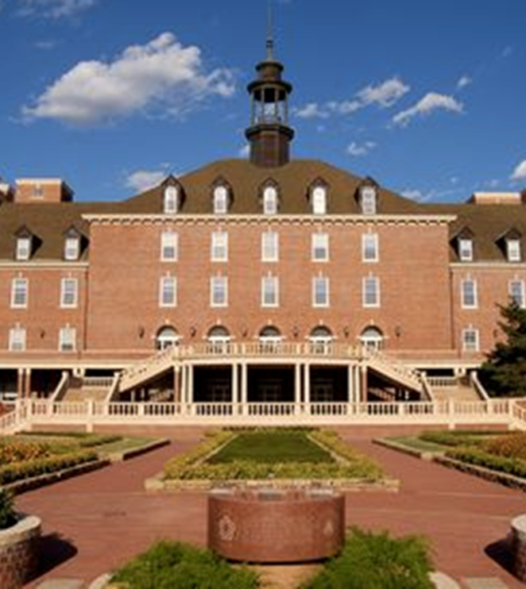
Reserving Space
Meeting Conference Services Reserves Space for the:
Student Union
Wes Watkins Center
Bennett Chapel
Table Space
Outdoor Space
Space is free inside the Student Union for student organizations unless the group is recouping any fees or if the space requires a tech. On-campus rates apply for the Wes Watkins Center and Bennett Memorial Chapel.

Slide 30
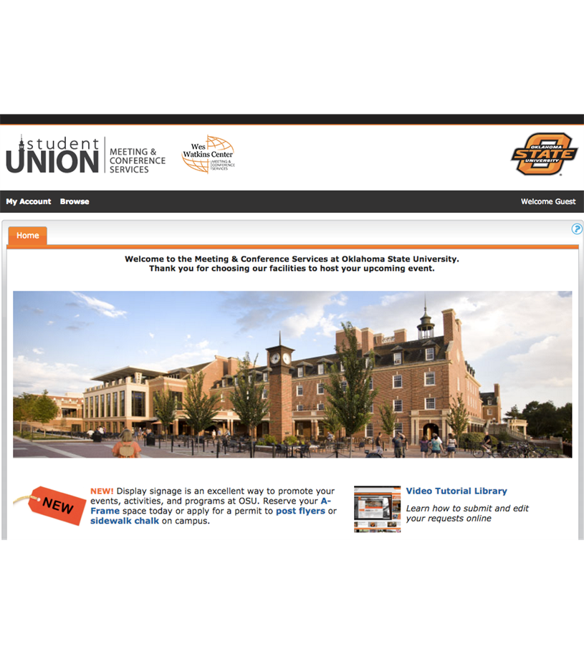
Reserving Space
Student groups can begin to reserve meeting space on:
October 1st for Spring Semester
February 1st for Fall Semester

Slide 31
Student Union, Wes Watkins, and Bennett Chapel Rates http://meetings.okstate.edu/rates

Slide 32
**New rules will be implemented this year. Please contact MCS for more details**

Slide 33
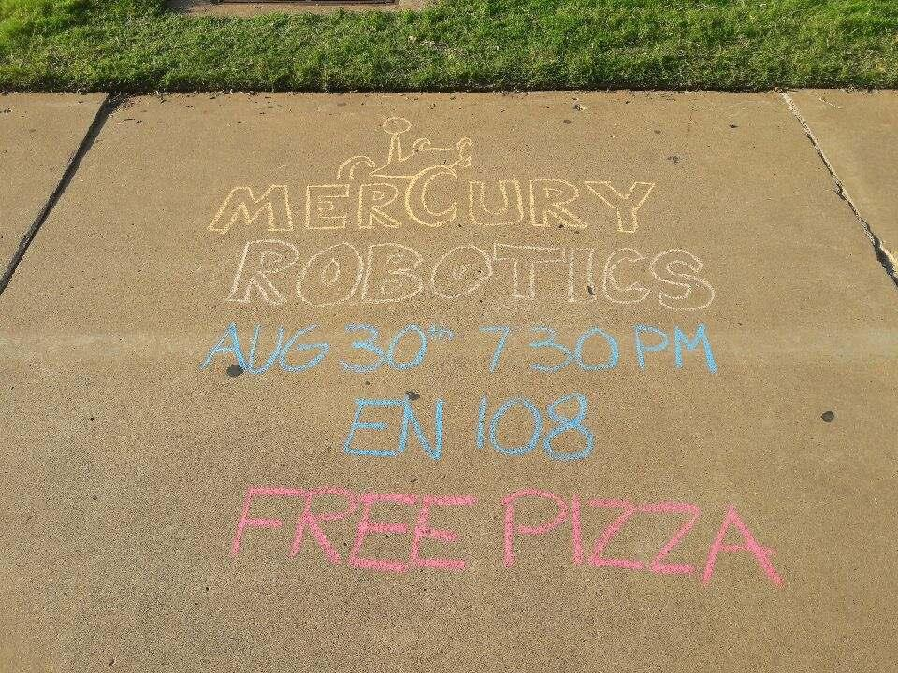
Flyer and Chalking Permits
If you have the poster ready for approval 10 business days before it needs to be distributed you can complete the online approval process.
If it is under 10 business days you will need to visit the office and complete the Campus Signage Request Form.

Slide 34
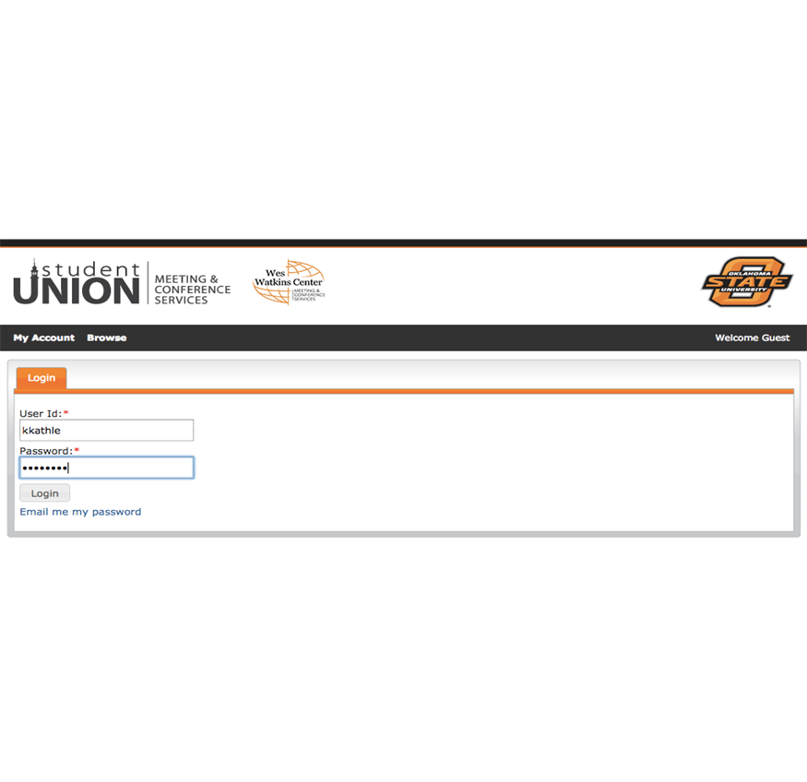
Virtual EMS
You Will Need to Log in Using Your:
Short OKey User ID
OKey Password

Slide 35
Communications 101
Kailey Rose
Student Union Communications Coordinator
311 Student Union
(405)744-5046 | kailey.rose@okstate.edu

Slide 36
Session Outline
What is Branding?
Public Relations Opportunities
Student Union Communications Coordinator Position

Slide 37
What is branding?
Your brand is your image. And your image is what helps you build and maintain your membership. Your brand is the persona your organization projects to perspective and current members as well as other influencers such as family members, alumni, faculty, etc.
Your reputation is what is going to make you sink or swim. Make your organization stand out in the best way possible and map out your way to success.
Lack of Planning
Inconsistent Brand Image
Producing Low Quality Content
Breaking Brand Promises
Underestimating Online Marketing Opportunities
Not Listening to Your Audience
Badly Designed and Hard to Navigate Website
Crossing Line Between Different and Offensive

Slide 38
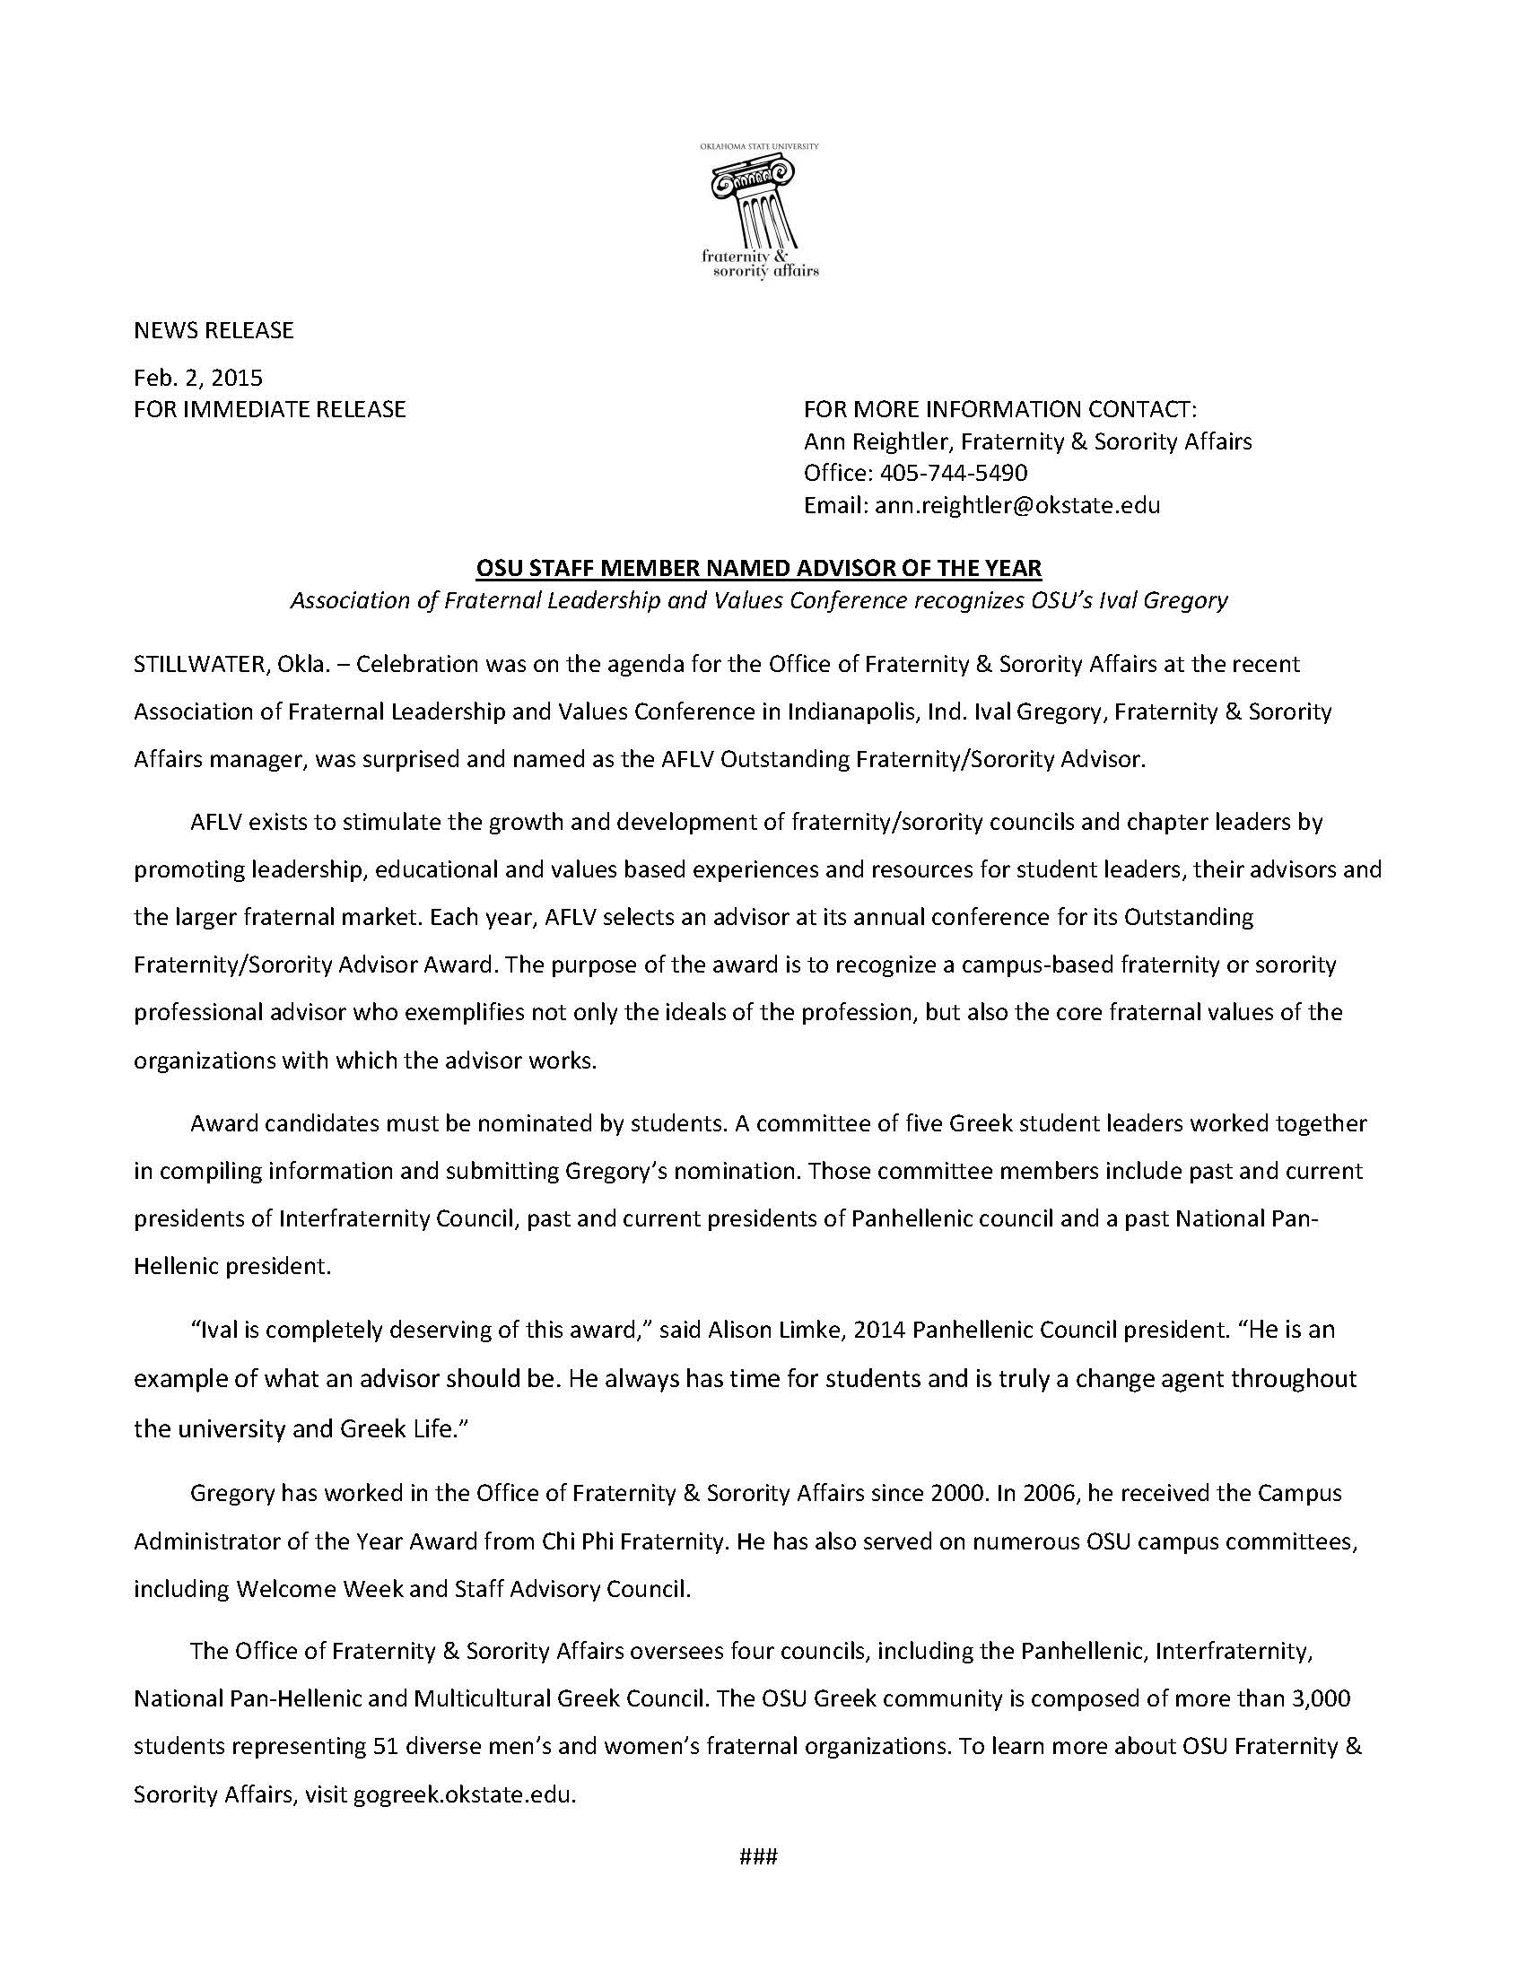
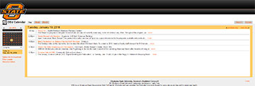
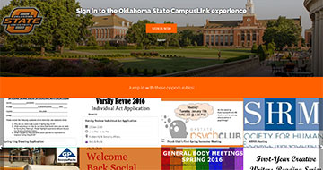
Public Relations Opportunities
Campus A-frames-
$60 per location for 10 working days
Set up through Meeting & Conference Services. Keep in mind required timeline to set up the appointment and plan accordingly.
- Artwork can be created on Student Union Marketing Department and has a required 4 week timeframe.
OSU Calendar (calendar.okstate.edu)
Leadership and Campus Life Information Desk can enter any event for you onto the university’s system calendar.
Press Releases
- For help with writing a press release contact OSU Communications.
CampusLink
- http://lcl.okstate.edu/campuslink-user-guide
Chalking
- For chalking permits visit: http://meetings.okstate.edu/
to set up reservations.
Campus Postings
- Fliers must be approved and stamped at the Meeting & Conference Services desk before they are posted on campus.
Digital Signage in the Student Union
- Guidelines with rates provided
Video Services
- Guidelines with rates provided

Slide 39
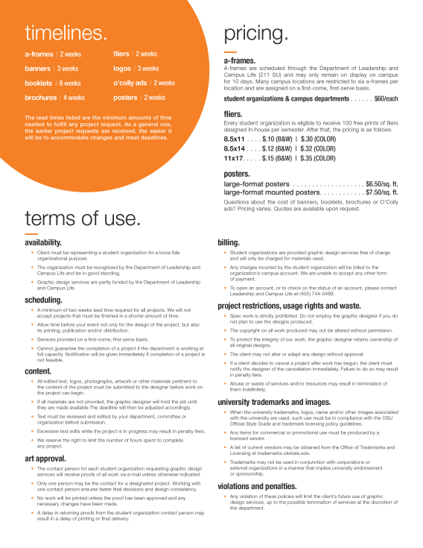
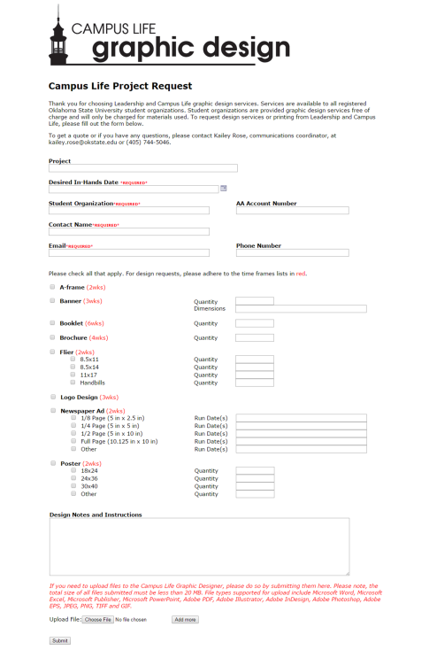
Student Union Communications Coordinator
Design and print services available, including social media and digital graphics
Policies, procedures and timelines (http://lcl.okstate.edu/sites/lcl.okstate.edu/files/u114/Campus%20Life%20Graphic%20Design%20Services_0.pdf)
Online marketing request
(http://lcl.okstate.edu/projectrequest)

Slide 40
Student Organization Marketing Examples

Slide 41
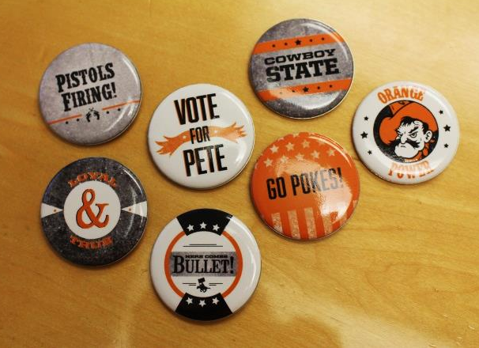
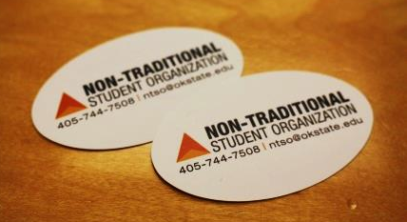
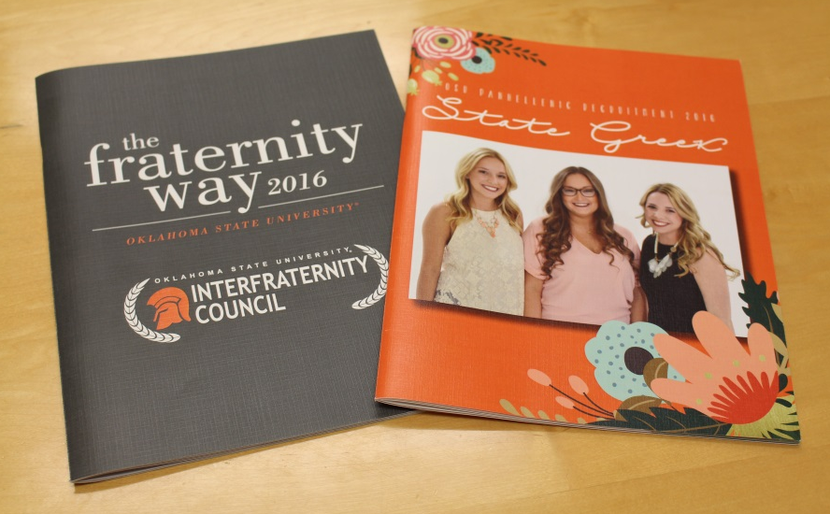
Student Organization Marketing Examples

Slide 42
Leadership and Campus Life
211 Student Union
Connor Terry
405-744-5486
Taylor Landon
405-744-8045

Slide 43
Leadership and Campus Life

Slide 44
Student Organization Resources

Slide 45
Leadership Training Provided
StrengthsQuest
Seven Habits of Highly Effective People
iLead Seminars
Social Change Model of Leadership
Ethical Leadership

Slide 46
Skills Training Provided
Goal Setting
Learning Outcomes
Mission and Vision Statements
Branding
Transitioning Information
Fundraising Basics

Slide 47
Updating CampusLink

Slide 48
Updating CampusLink

Slide 49
Organization Status
Active Organizations: Registered or recognized organizations have all of the rights of a student organization – room reservations, posting fliers, AFAP Funding (recognized), OSU email, and University Accounting
Frozen Organizations: Do not have current information on CampusLink. The organization will not be visible on CampusLink. Members will not have student organization privileges

Slide 50
CampusLink- Documents
Please start to place important documents on CampusLink within your “Documents ” folder.
These documents should contain:
Organization Constitution
Organization Minutes
Group Contact List
Applications, Letters, etc.

Slide 51
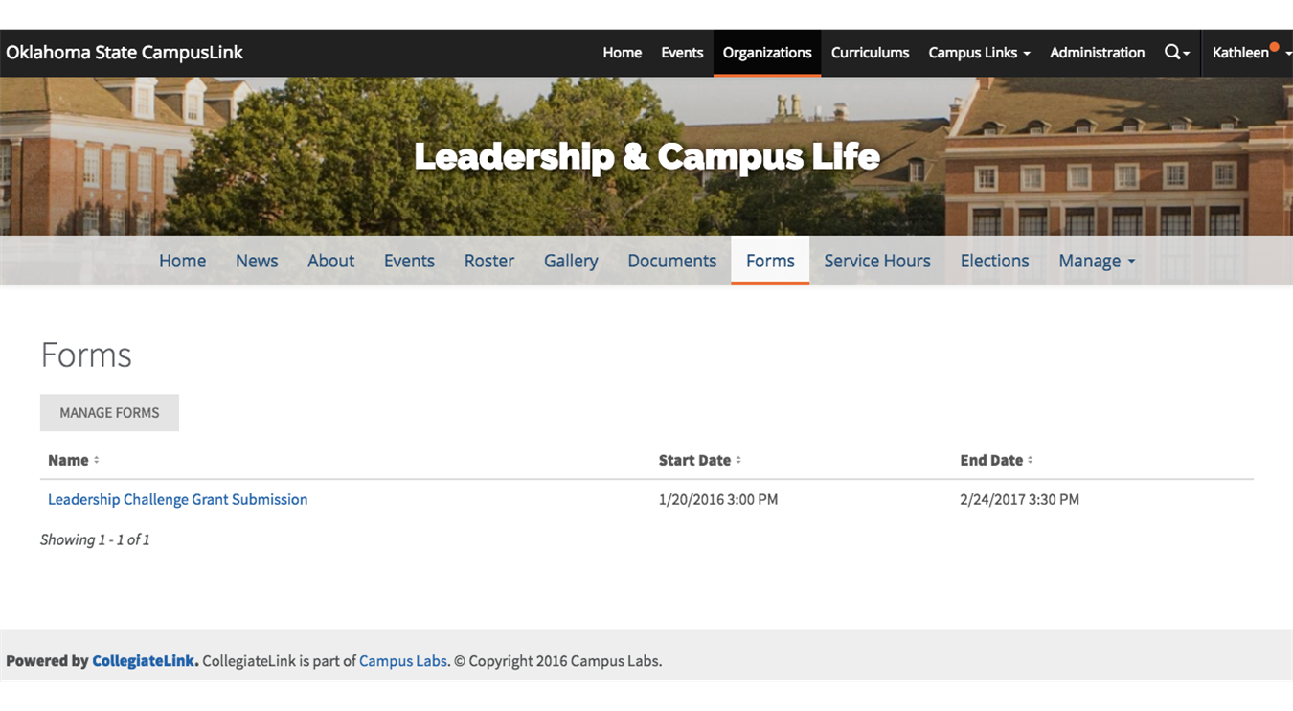
CampusLink- Forms

Slide 52
CampusLink- Create an Event
Event Flyer Size – 1024px by 600px or larger
10mb limit
Must be JPEG, JPG, GIF, PNG, and PDF
All materials created by marketing complies with regulations

Slide 53
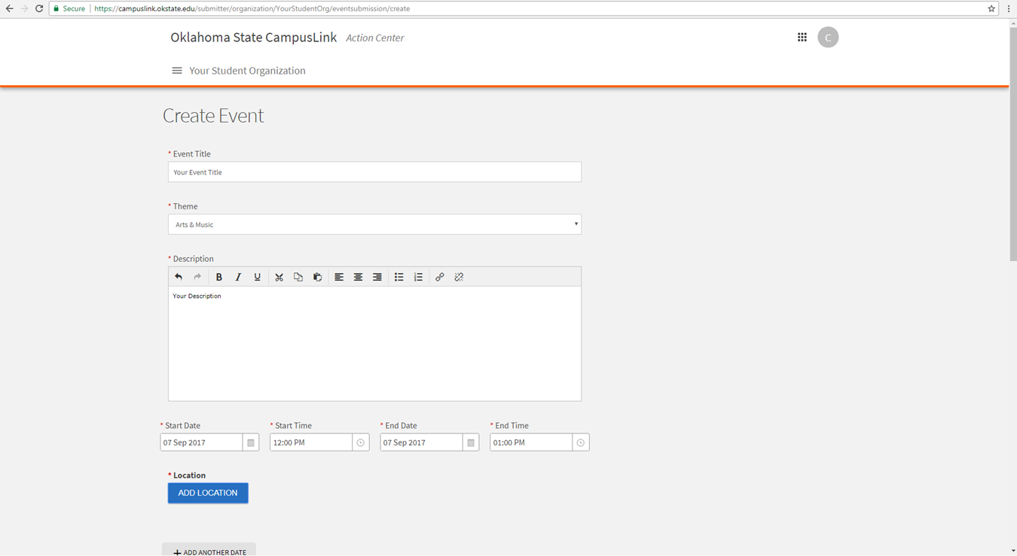
CampusLink- Create an Event

Slide 54
CampusLink User guide

Slide 55
Student Volunteer Center
211 Student Union
405-744-7673
Anamal Hasan

Slide 56
Student Volunteer Center
CORD Program:
400 Hours of Community Service as an Undergraduate
300 Hours of Community Service as a Graduate Student
All Hours Must Be Reported in CampusLink
There has been a total of 878,006 service hours reported in CampusLink to date!

Slide 57
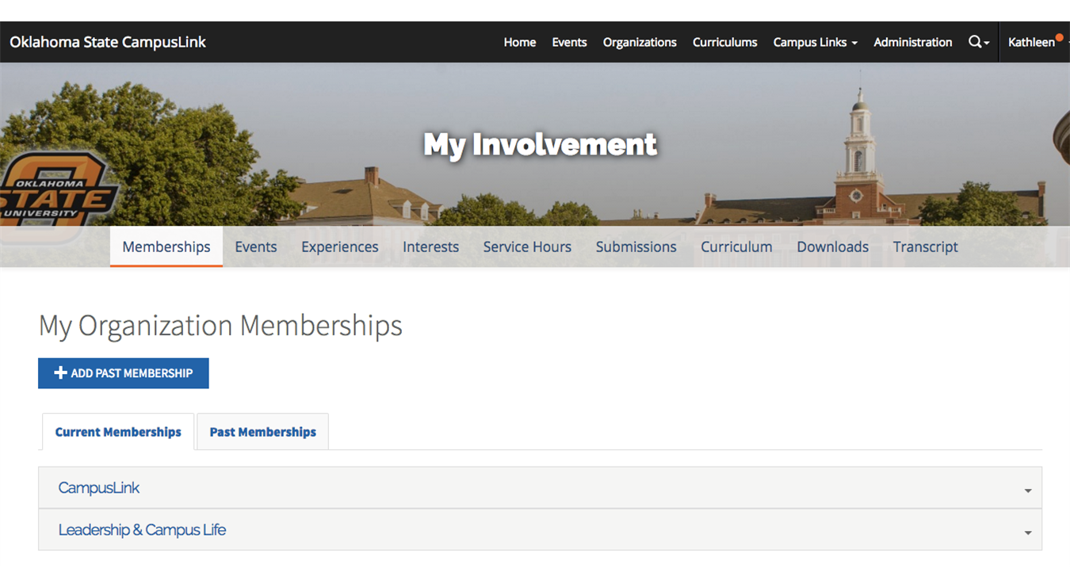
Record Your Service Hours on CampusLink Go To: My Involvement

Slide 58
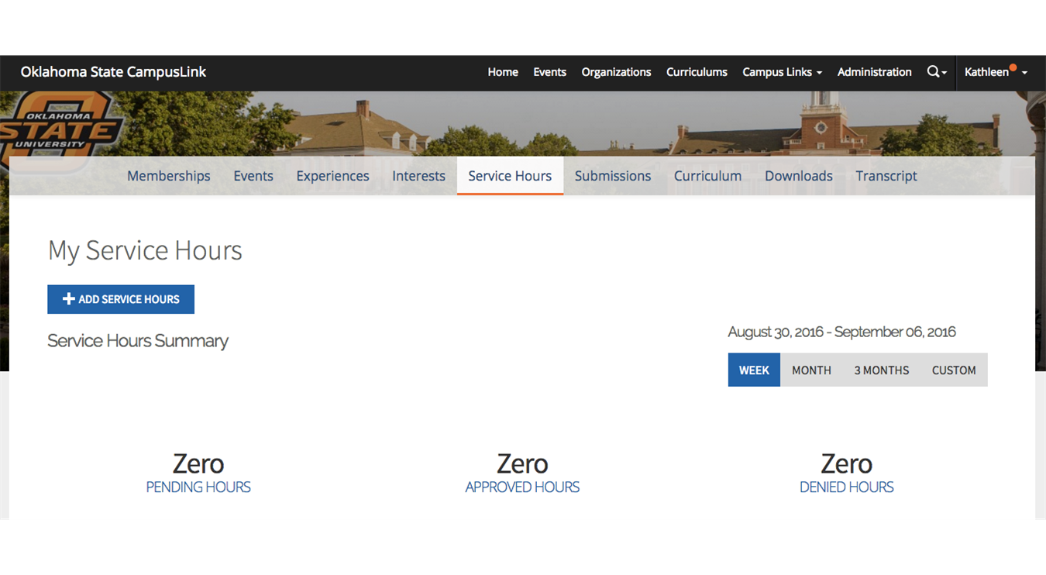
Record Your Service Hours on CampusLink Go To: Service Hours + Click Add Service Hours

Slide 59
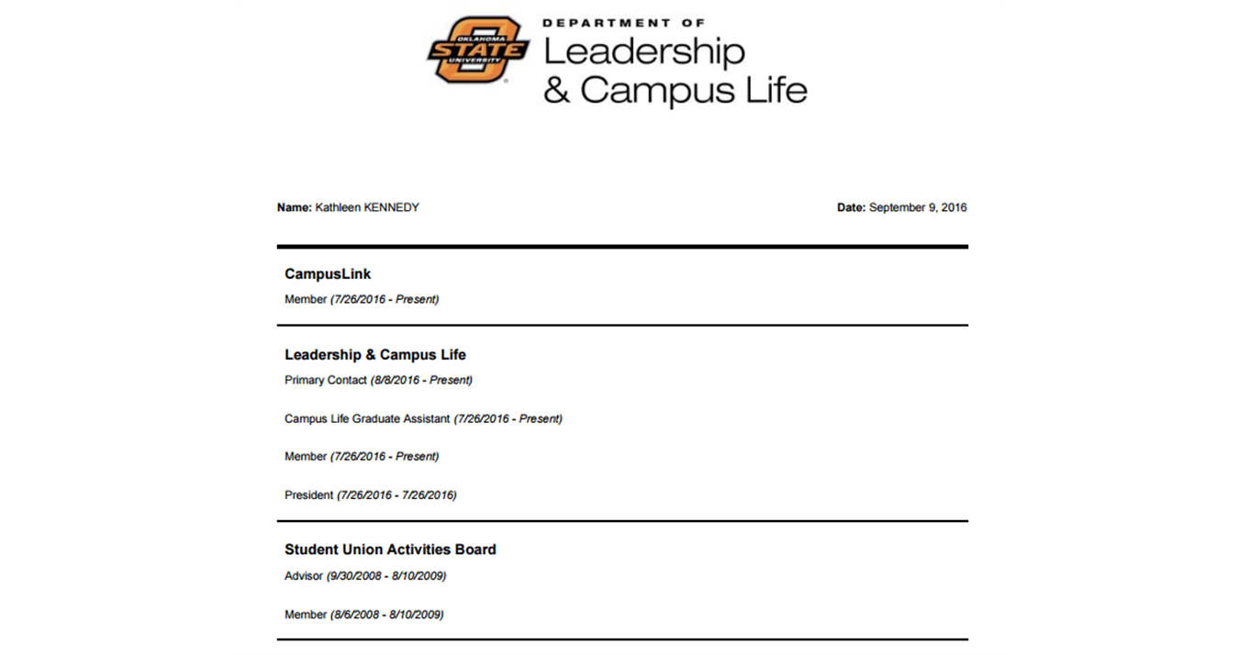
CampusLink Transcript
tracks all of your service hours and organizational involvement

Slide 60
Questions?

