Slide 1
Unsure about how to decide which sorority to join? Review this presentation to learn more about the mutual selection process!

Slide 2
Mutual Selection
• Method utilized during recruitment in which chapters
submit their invitation lists while potential new
members (PNMs) submit their preferences.

Slide 3
Submitting Preferences
• Called “preffing” for short.
• Process in which PNMs submit a list of their favorite
options via computer.
• Occurs at the end of each event round of fall
recruitment.

Slide 4
Recruitment Format
13-10-6-2
• First round (Open House Round): PNMs attend events at all 13 chapters on Sunday and Monday.
• Second round (House Tour Round): PNMs attend a maximum of 10 chapters on Tuesday and Wednesday.
• Third round (Philanthropy/ Sisterhood Round): PNMs attend a maximum of 6 chapters on Thursday.
• Fourth round (Preference Round): PNMs attend a maximum of 2 chapters on Friday.

Slide 5
Definitions
• ICS: Intercollegiate Solutions; name of the online database used to facilitate fall
recruitment; where you enter your preferences on the computer.
• Cluster: Refers to the group of your favorite chapters; represents your ideal
schedule for the following event round.
• Rank: Refers to the remaining chapters; represents the preferential order of the
chapters you would like to return to if any of the chapters in your cluster do not
invite you back; allows you to maximize your options.
• Maximizing your options: The recruitment process strives to give every woman
the greatest opportunity possible to join a chapter; therefore, your schedule will
include as many chapters as possible based on your preferences and the
invitation lists of chapters.

Slide 6
Patty PNM
To explain the mutual selection process in detail, we are going to use
Patty PNM as an example. Potential new member, Patty, submitted
her preferences on Tuesday night and on Wednesday received a schedule
to attend eight events during the second event round. On Wednesday
night once the second event round is complete, she will cluster her
favorite six organizations and rank the remaining two. If she had
only been invited to six events instead of eight, she would just cluster
those six groups.

Slide 7
Wednesday’s Schedule (8 Chapters; 2nd Round) : ABC, DEF, GHI,
JKL, MNO, PQR, STU, VXY
Patty clusters her favorite 6 Patty ranks her remaining choices
(in no specific order) (In order from most connection to • STU least connection)
• ABC • PQR 1. DEF
• GHI • JKL 2. MNO
• VXY

Slide 8
Frequently Asked Questions
1. Why are there only eight chapters on Patty’s schedule for Wednesday?
There is a maximum number of events you can attend each event round of recruitment. The system will place you with as many chapters as possible based on your preferences. However, the system cannot place you with a chapter that has not extended you an invitation. It is common for women not to attend the maximum number of events. Because every woman is ultimately narrowing down her options to one chapter, it is not important how many you have at any particular point in the process.
2. Does the order of the organizations in the cluster matter?
No, ICS does not recognize the order of the clustered chapters, and thus they appear in alphabetical order. The cluster represents your ideal schedule for the next event round.
3. Why do you only cluster a certain number of organizations?
The cluster represents your ideal schedule for the next event round. Therefore, you cluster your favorite group based
on the maximum number of events you could attend each event round. The previous slide entitled “Recruitment
Format” lists those numbers.

Slide 9
Frequently Asked Questions
4. Why would Patty cluster all seven chapters if she only had seven on her
schedule?
The mutual selection process requires you to maximize your options in order to have
the best opportunity possible to join a sorority during fall recruitment. Therefore, if
the number of chapters you have remaining matches the maximum number of
chapters you could visit during the next event round, then your ideal schedule would
be to visit all of them again.

Slide 10
Scenarios
1. Patty is matched to all of her clustered chapters
(i.e. Patty is invited back to her favorite 7 chapters).
In this case Patty’s schedule would include the following chapters:
• ABC
• GHI
• JKL
• MNO
• PQR
• STU
• VXY

Slide 11
Scenarios
2. Patty is not matched with chapter ABC; however, DEF has invited Patty back.
In this case Patty’s schedule would include the following chapters:
• DEF
• MNO
• PQR
• GHI
• JKL
• JKL
• STU
This has MAXIMIZED Patty’s options by allowing her to revisit a chapter that she had ranked.

Slide 12
Scenarios
3. Patty is not matched with ABC or DEF (i.e. these chapters have not
invited Patty to return), but VXY did issue her an invitation.
In this case Patty’s schedule would include the following chapters:
• PQR
• STU
• VXY
• JKL
• GHI
• MNO
This again has maximized Patty’s options.

Slide 13
The following is a screenshot from ICS.
This is how the computer screen will look after
you have clustered and ranked your preferences.

Slide 14
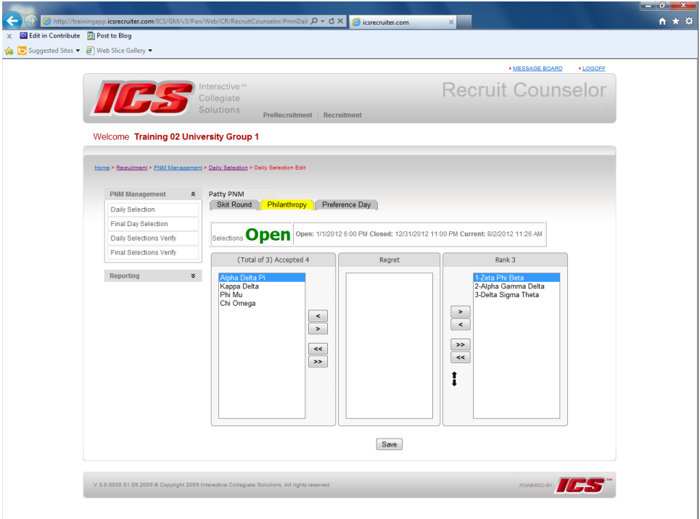

Slide 15
“Releasing”
By ranking the chapters you prefer the least, you are not releasing those organizations. You are saying that if any of the organizations in your cluster do not invite you back, then you would like to have these three chapters added to your schedule in this preferential order so long as they issue you an invitation.
Chapters do release women. Each organization is provided a maximum number of women to invite back by the Panhellenic Council based on a statistical algorithm called Release Figure Methodology. Therefore, if a woman does not appear on any chapter’s invitation list, she is completely released from recruitment. Further, each national organization prescribes for her chapters the way they will execute the task of selecting members. These processes are confidential. In general, the chapters are looking at your academic record and campus and community involvement. Sororities are values-based organizations; therefore, they are looking for women who value what they value as a group.

Slide 16
Completely Released
If a woman does not appear on any chapter’s invitation list, she is completely released from recruitment.
As previously explained, each national organization prescribes for her chapters the way they will execute the task of selecting members. These processes are confidential, so women cannot discover why they have been released from any organization.
In general, the chapters are looking at your academic record and campus and community involvement. Sororities are values based organizations; therefore, they are looking for women who value what they value as a group.

Slide 17
MRABA
If you persist through the recruitment process and are invited to the fourth event round (Friday/Preference Day), you will be asked to sign a contract known as the Membership Recruitment Acceptance Binding Agreement (MRABA) on Friday night. This contract states in part that you promise to accept a bid from the up to two chapters you list on the contract. Basically, the contract represents your final preferences of the week. If you maximize your options (i.e. list all the chapters you attended events at on Friday), then you are guaranteed a bid from one of those sororities on Saturday. You may only list organizations you visit on Friday. Listing your preferences on the MRABA doesn’t mean you will receive a bid from your first choice. If you choose not to accept a bid from an organization that you have listed on your MRABA, then you will not be permitted to participate in recruitment until fall 2019. If you do not maximize your options by listing all of the chapters you attend events with, then you are not guaranteed a bid on Saturday. Please note that you can choose not to sign the MRABA. However, if you do choose not to sign the contract, you will not be able to continue participating in fall recruitment. Basically, you are electing to withdraw from the process.

Slide 18
Intentional Single Preference
The act of not maximizing your options is known as Intentional Single Preference (ISP). If you ISP and do not receive a bid, you are eligible to participate in Continuous Open Bidding (COB) immediately. It is important to understand the concept of ISP. If you are 100% certain you would not accept a bid from a chapter you visited on Friday, you should not list them on your MRABA because you could very well be offered a bid from them on Saturday, decline the bid, and end up ineligible for recruitment for a year. However, if you do ISP, then you are not guaranteed a bid on Saturday but can participate in COB immediately if you would like to. COB will occur for chapters that are below the established maximum number of members as set by the Panhellenic Council. That is known as Chapter Total and is calculated based on median chapter size. Not every chapter will be eligible to participate in COB. Eligible chapters are not required to participate by the Panhellenic Council. Therefore, there is no guarantee that COB will take place or that a sorority you are interested in will be participating.

Slide 19
Contact Us
If you have questions or concerns about the
mutual selection process, please reach out to us.
Phone: 405-744-6583
Email: sororityrecruitment@okstate.edu

